Slide 1


King County Washington
Housing Dataset Analysis
Author: Brennan Mathis

Slide 2
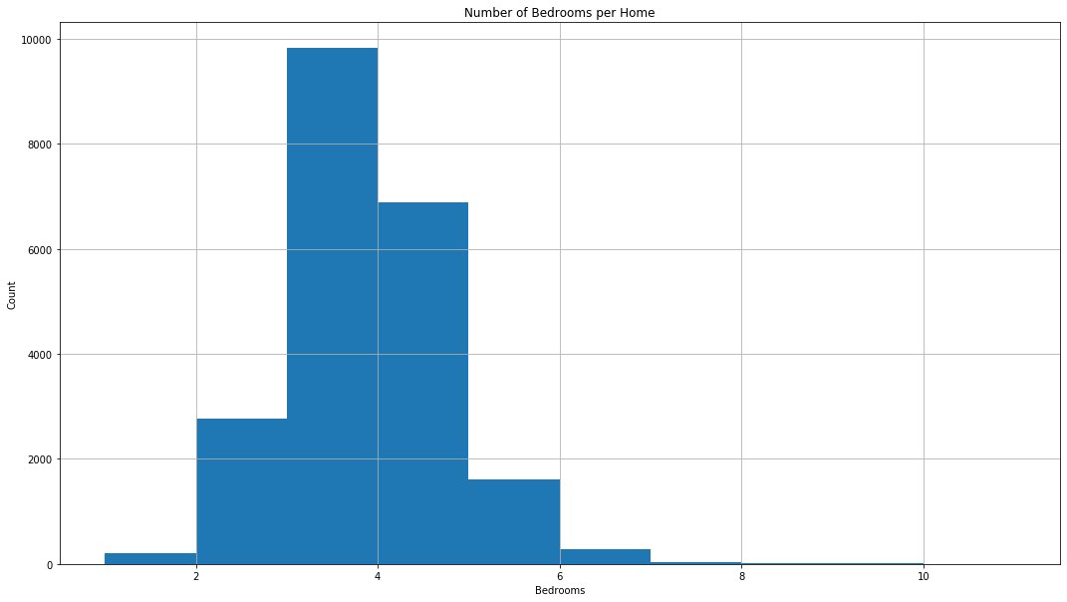
Average Home Price: $540,297 Average Number of Bedrooms: 3.4 Average Price for 3 BR House: $466,294

Slide 3
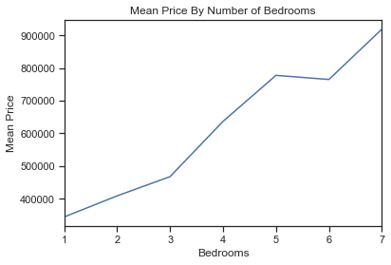
Each bedroom in a home can increase the value of a home by an average of $127,573

Slide 4
1 Bedroom: $ 318,239 2 Bedroom: $ 200,693 3 Bedroom: $ 155,431
Average Bedroom Price
Per Bedroom in Home
4 Bedroom: $ 158,891 5 Bedroom: $ 157,374 6 Bedroom: $ 137,642

Slide 5
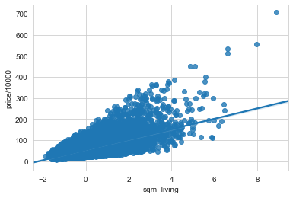
Square Meter Living Area Vs. Price ($10,000)
Each individual square meter of living area
can increase value of the home by 0.4%

Slide 6
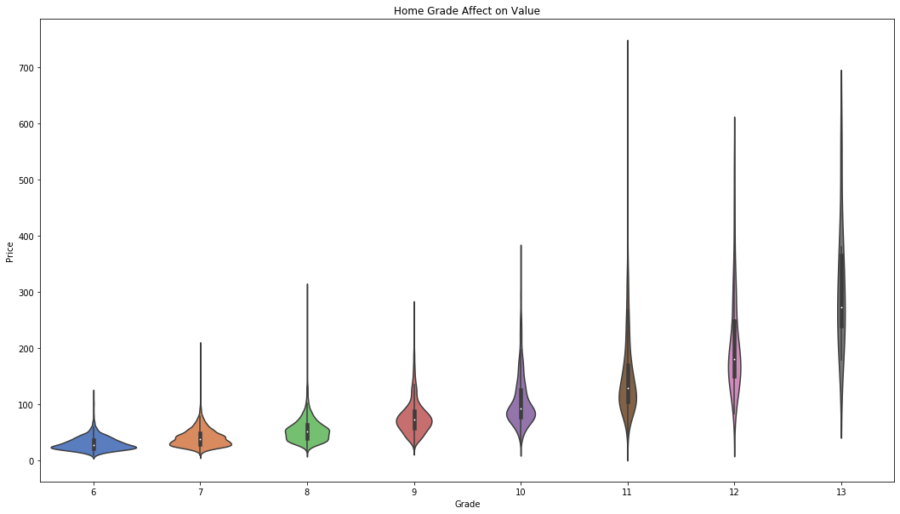
Grade Effect on Price
Every increase in grade unit can increase home value by 32%

Slide 7
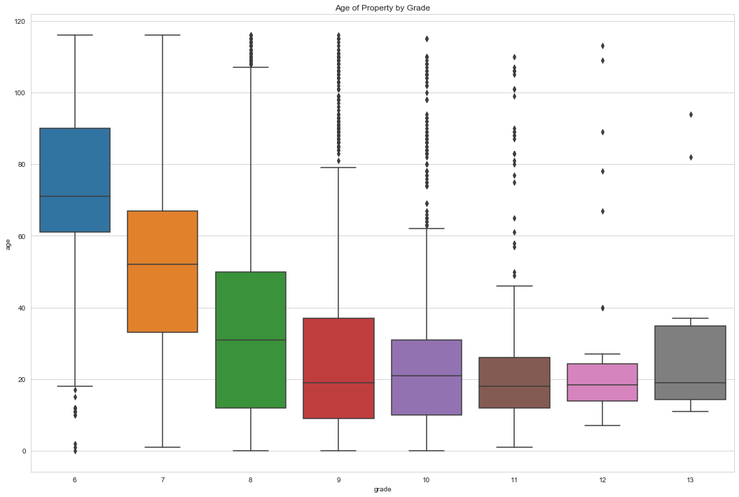
Relationship between Home Grade and Age

Slide 8
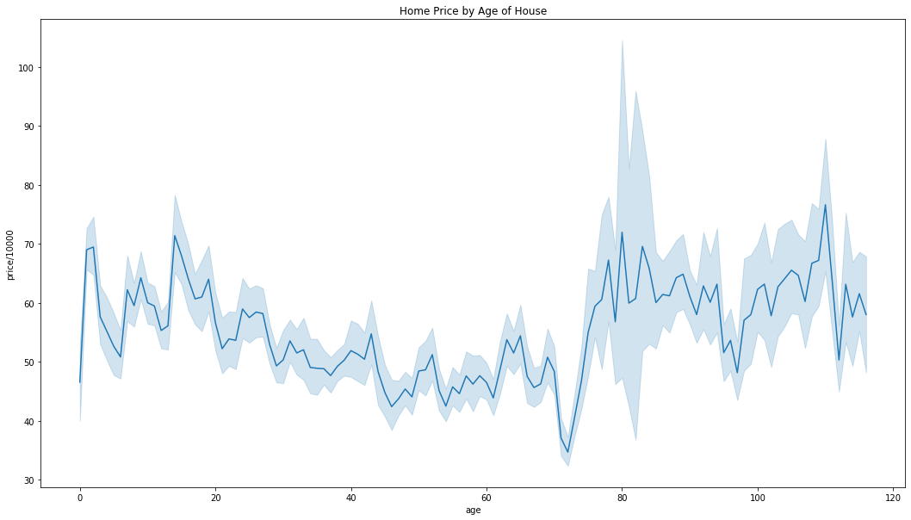
Home Age Affect on Value
Condition and Grade have a stronger overall effect on price, especially on older properties,
some of which present much higher values dependent on those criteria

Slide 9
Renovated Homes Non-Renovated Homes
Average Price: $ 768,902
Average Grade: 7.75 out of 13
3% of homes are renovated
Average Price : $ 532,140
Average Grade : 7.65 out of 13
97% of homes are not renovated
Average Price for Non-Renovated Homes with Grade over 7: $ 701,337
Renovating your home before selling can increase the value of your home by over $60,000

Slide 10
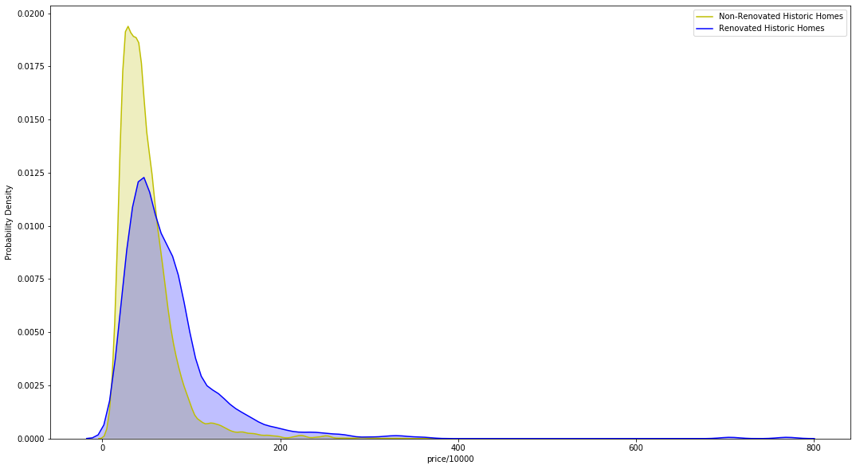
Renovation Effect on Homes Over 50 (Years Old)

Slide 11
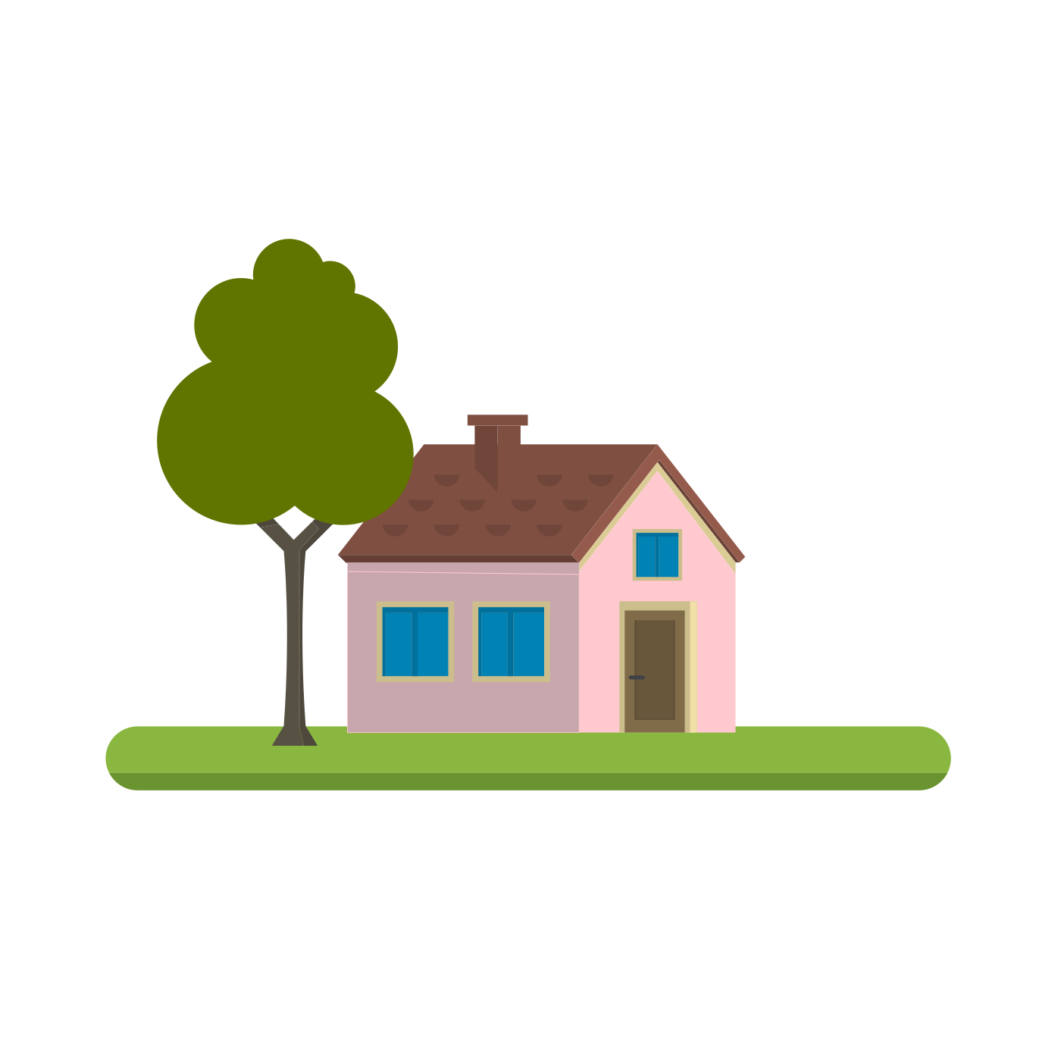
Thank you.

